Slide 1
SMART WASTE MANAGEMENT
STUDENT 1: 7376211EC140 – GEETHIKA S M
STUDENT 2: 7376212AD143 – INDHU REKHA U
STUDENT 3: 737621AD209 – SUBRAJASHREE D
STUDENT 4: 7376211EC107 – AMALA K
Under the guidance of
Mr. Tamilselvan
Assistant professor, ECE
BIT, SATHY

Slide 2
Abstract
In order to reduce the over-dumping of garbage, we can automate the garbage bin to send information to the authorities and drivers through mobile applications. Once the waste bin reaches a threshold level, it also intimates the people where the next closest dustbin is available for use.2/3rd of total deaths are due to stroke, cancer, and respiratory disease.12.6 million deaths every year are caused due to an unhealthy environment. It also measures the toxicity level of waste in landfills and intimates the workers of the danger level, so that the garbage goes to the next level to eliminate the toxicity and comes back to segregation. By doing so, we can avoid hazardous diseases and create a clean and healthy environment. Also, the most frequently produced plastic waste in developing nations regularly winds up in open unregulated dump destinations or is tossed into waterways and streams. So, it can be used cost-efficiently by combining with other metals.

Slide 3
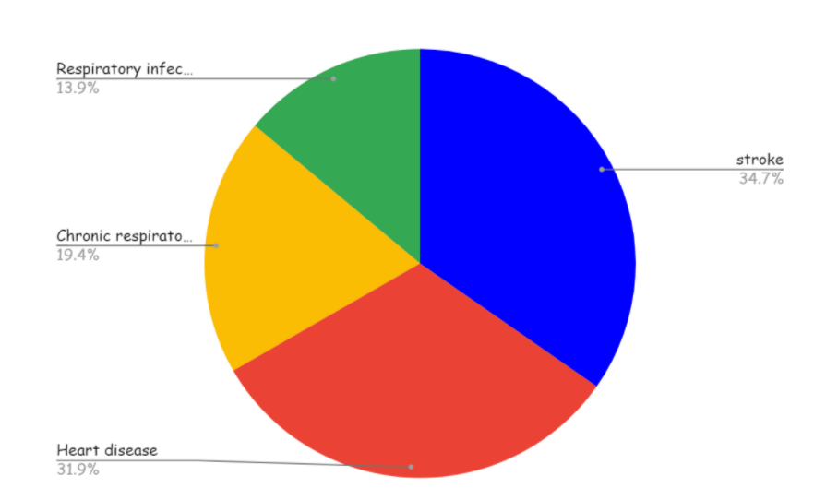
PROBLEM STATEMENT ADDRESSED
Authorities are not intimated properly or they aren't aware of the level of dustbins whether it has been filled or not. So, If waste is dumped in the dustbin for a long time, hazardous gasses are produced by which toxicity level increases. Hence, public people, especially sweepers and cleaners, are prone to diseases. Hence, through this mobile application, we can intimate the authorities to clear the waste once the bins are filled and measure the toxicity of waste to ensure whether it can be used for recycling. Also, the display near the bins is to make people aware not to over dump and also to search for other bins for disposal of waste.
Statistical reports indicate that India produces nearly 42 million tons of solid waste per year and also the report on the presence of toxic gases in the solid waste and a graphical representation of the death rate due to the unhealthy environment is given below.
State | Amount of waste produced
Ahmedabad | 6.3 million
Bangalore | 8.4 million
Chennai | 8.6 million
Delhi | 16.4 million
Mumbai | 18.1 million
Hyderabad | 7.7 million
Kolkata | 14.1 million
Major Constituents | Percentage
Methane | 30% - 60%
Carbon-dioxide | 34% - 60%
Nitrogen | 1% - 21%
Oxygen | 0.1% - 2%
Carbon monoxide | 0 - 0.2%
Hydrogen | 0 - 0.2%
Ammonia | 0.1% -1%

Slide 4
THE EXISTING SOLUTIONS FOR THE PROBLEM ADDRESSED
Landfill
Usually, a gas extraction system is put in to extract gas (arising out of decomposition) through a burrow pit. However, this method has its own shortcomings. It leads to the emission of major greenhouse gases such as Methane which can be poisonous for us to breathe in as well as is responsible for the Greenhouse effect. According to the EPA, landfill gas energy captures 60-90 percent of methane emitted, and the rest gets released into the atmosphere. The most common & probably one of the most dangerous methods of waste treatment. It involves the waste being buried in landfills and these landfills can be found in any city. The logic behind burying the waste is to create compression & hence, enhance its density and making the filling stable. It is then coated to minimize the possibility of vermin
Incineration
This waste treatment method involves exposing the waste to high temperatures to trigger combustion and ultimately reducing it to ashes, gas, and heat energy. The method is commonly used to treat hazardous industrial waste in a chamber or boiler to extract energy. However, the majority of waste produced in India is not industrial. Hence, this method is not feasible as it involves a high cost of treatment because of the controlled factors involved.

Slide 5
The Solution to the Problem Addressed
To intimate the information to the authorities and truck drivers via mobile application Dart language is used. This app provides the location of various nearby garbage using which the municipal corporation will be aware of an overflow of garbage and this app also measures the toxicity and indicates the level of toxic gas in the respective garbage. To indicate the two threshold levels in the garbage, an ultrasonic sensor is used and the toxicity is sensed by other various sensors(prototype explanation)

Slide 6
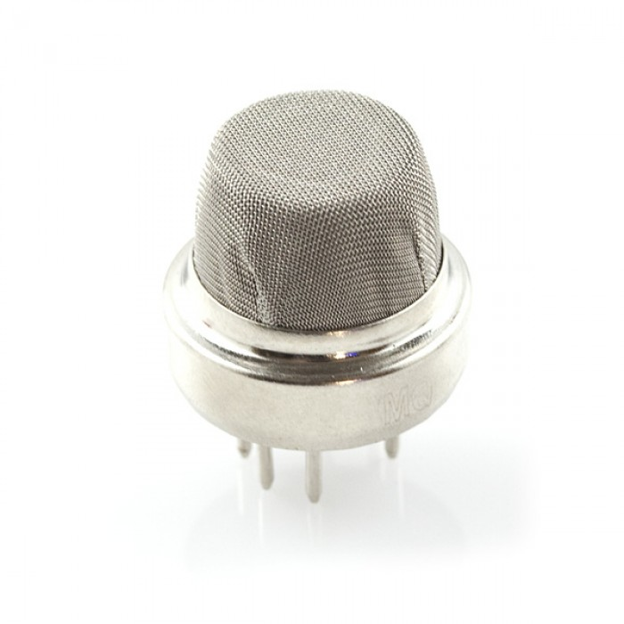
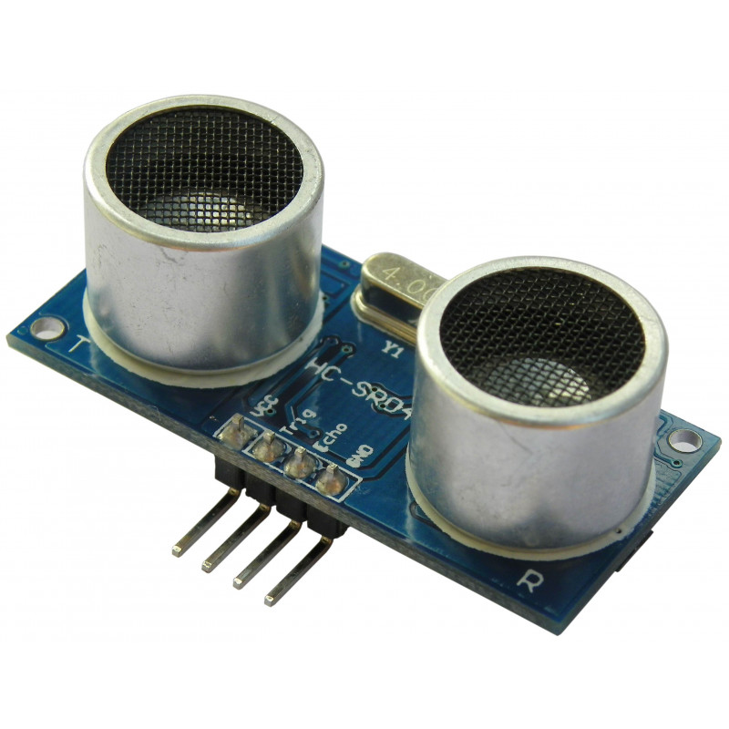
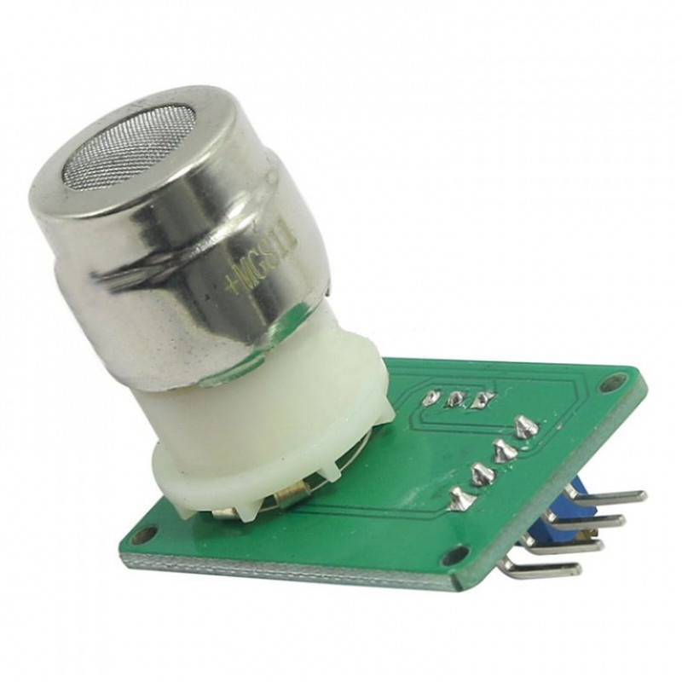
PROJECT WORK PLAN
Ultrasonic sensors are used to identify the level of garbage in the bin. Once the threshold level is reached ,the intimation is sent to the authority via mobile application. The gas sensors( Mq4 methane gas sensor and Mg811\SCD40 for measuring CO2) are used to identify the toxic gases in the bin. MQ4 Methane Gas Sensor detects the concentration of methane gas in the air and outputs its reading as an analog voltage. The concentration sensing range of 300 ppm to 10,000 ppm is suitable for leak detection. For example, the sensor could detect if someone left a gas stove on but not lit. The sensor can operate at temperatures from -10 to 50°C and consumes less than 150 mA at 5 V.
MQ4 Methane gas sensor CO2 gas sensor Ultrasonic sensor

Slide 7
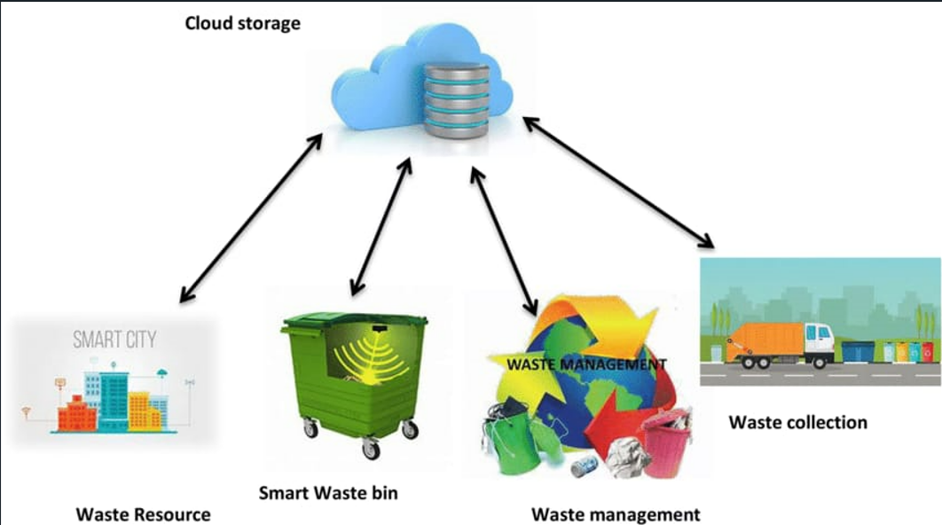
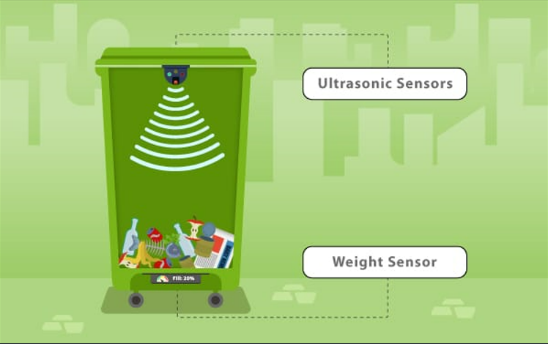
BLOCK DIAGRAM

Slide 8
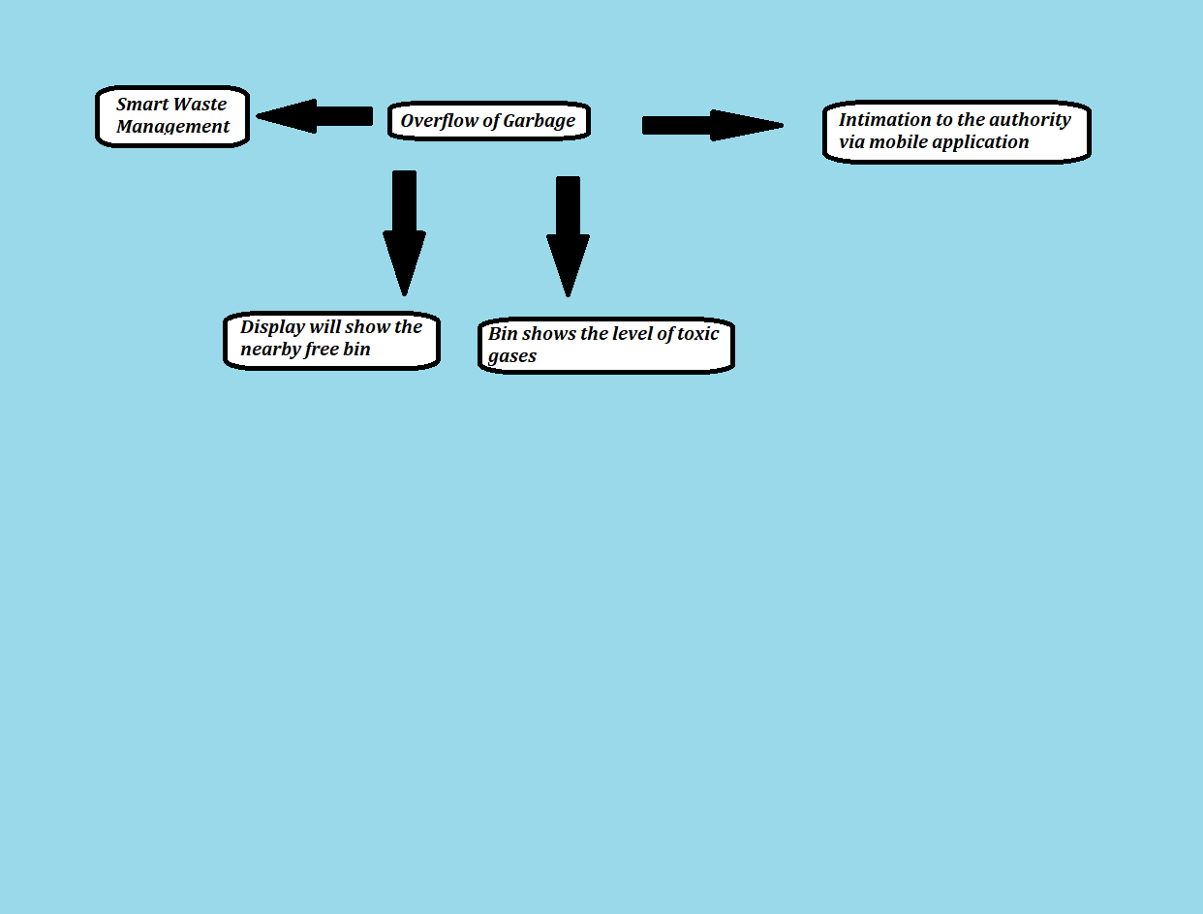
FLOW CHART

Slide 9
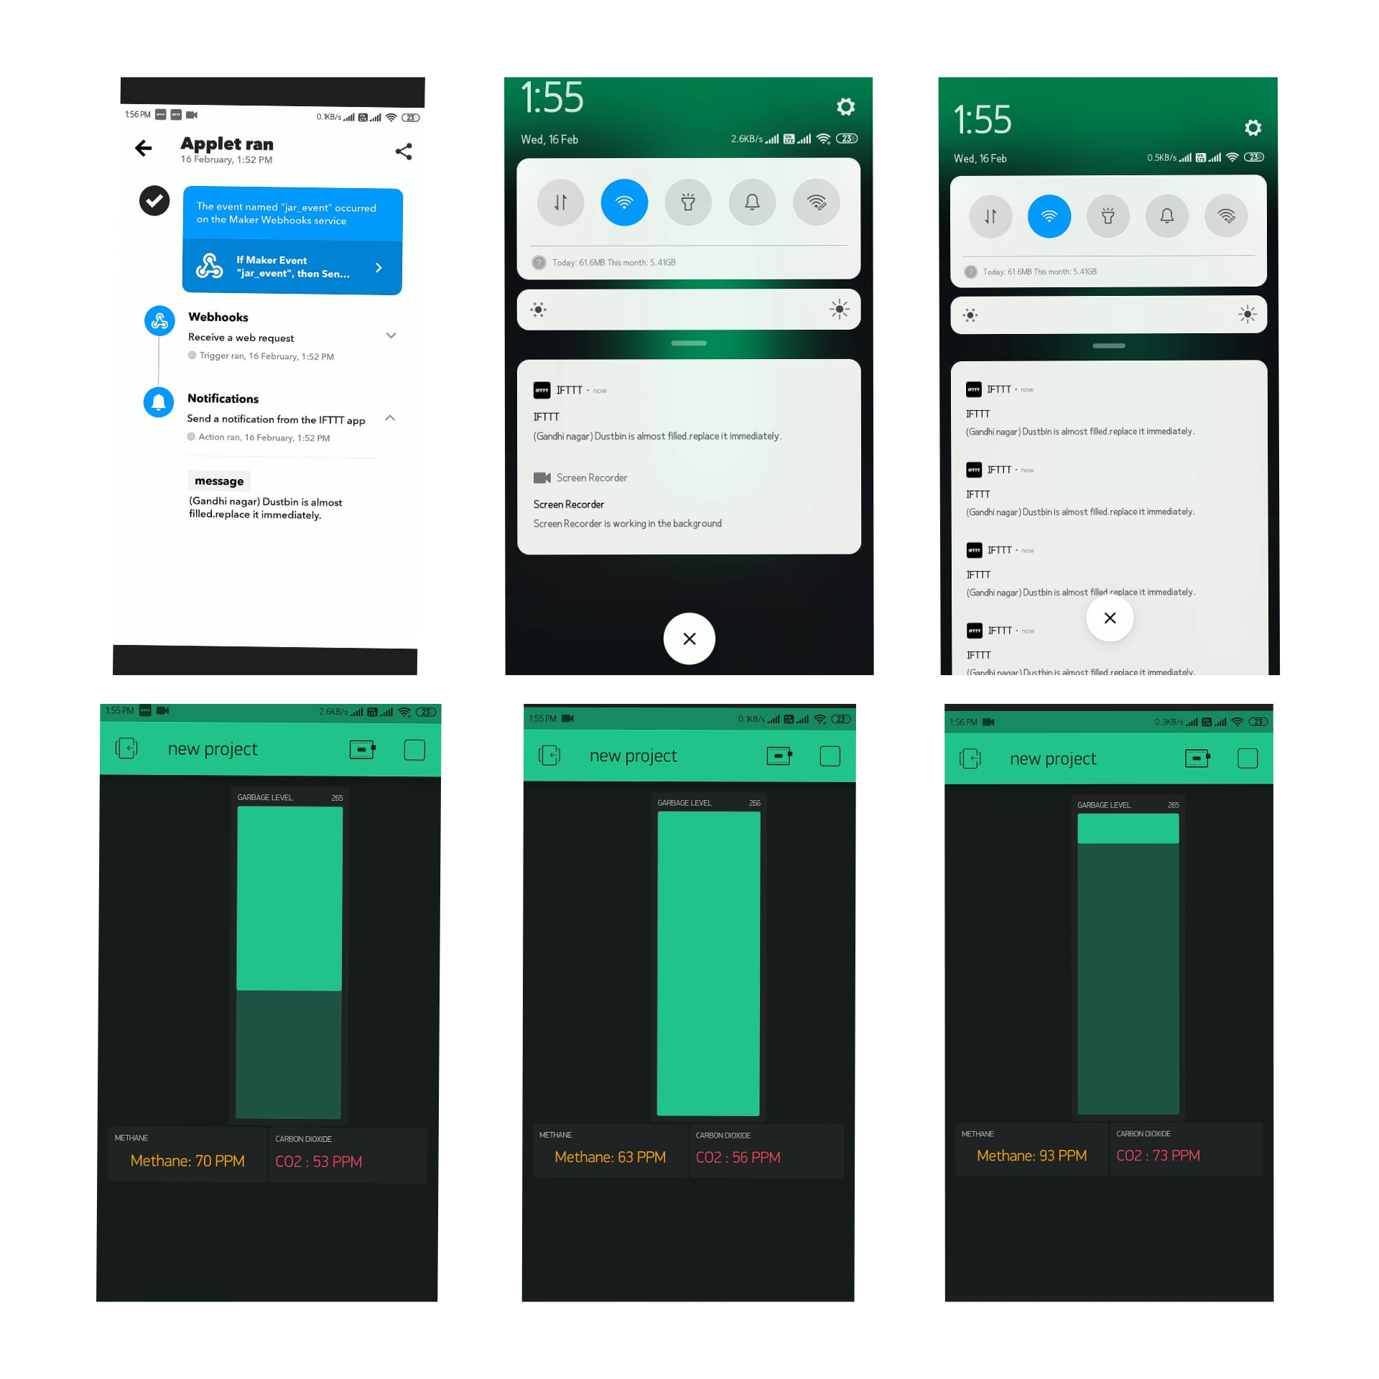
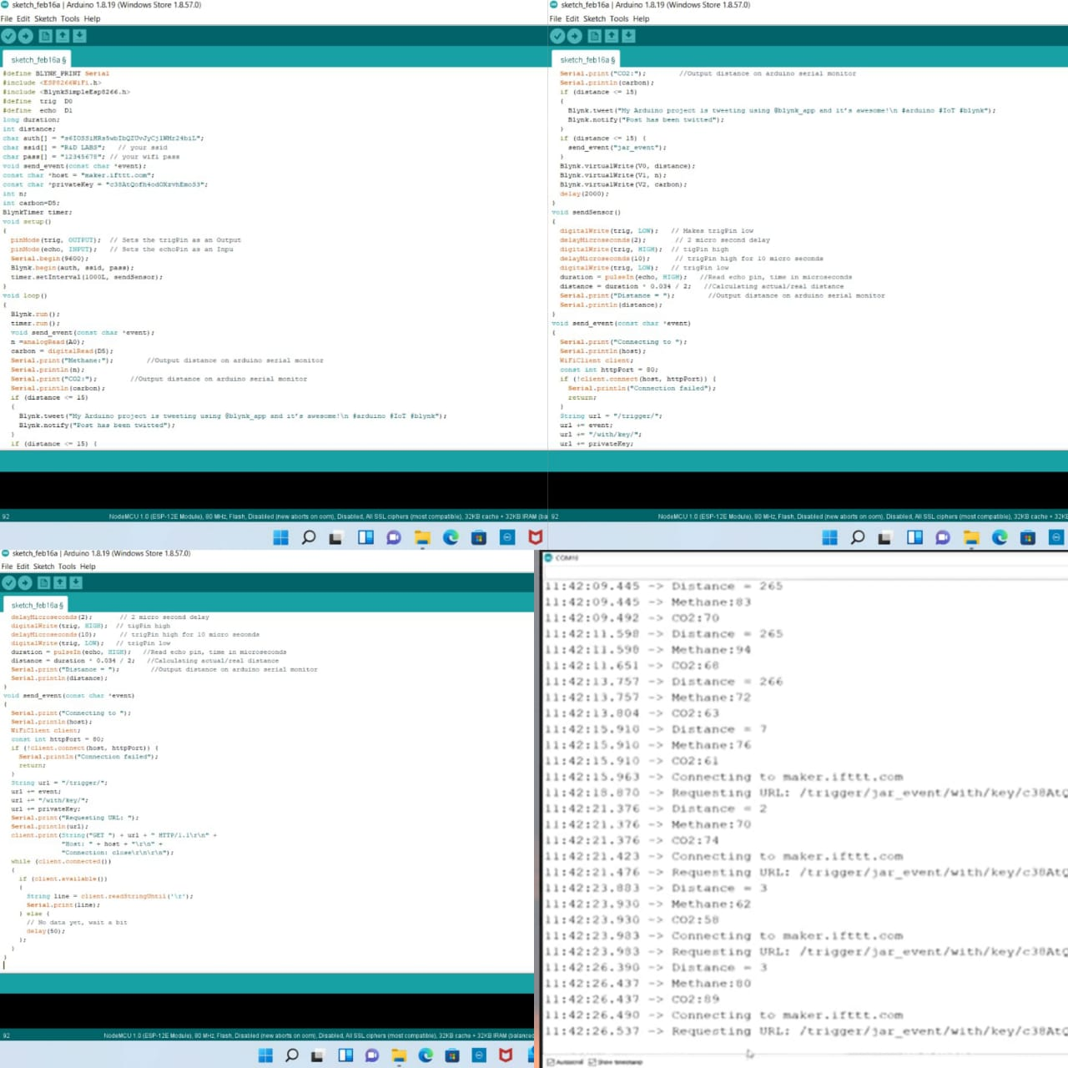
Effective Utilization of Modern tools & Cloud
Working model of the application Code and the Output

Slide 10
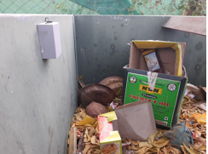
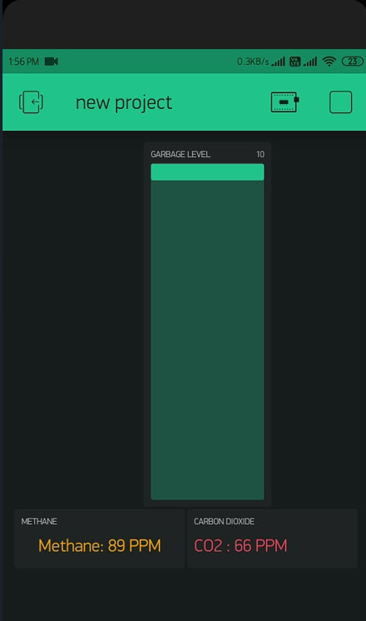
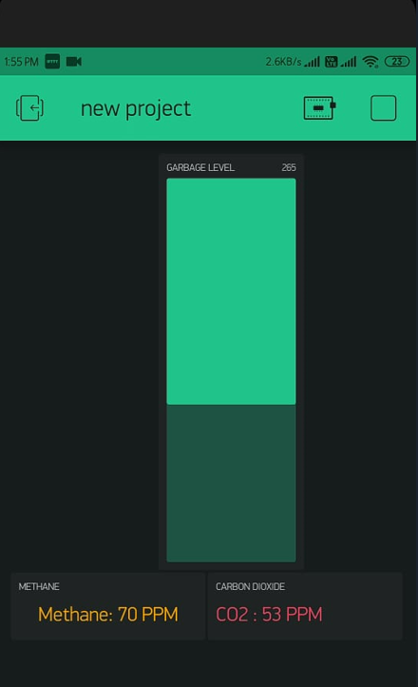
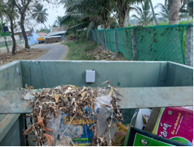
PROTOTYPE AND SAMPLE OUTPUT
PROTOTYPE
SAMPLE OUTPUT

Slide 11
Analysis of results and Discussions
Analysis of the results:
The garbage level is found using ultrasonic sensors and the toxicity is measured using gas sensors and intimated to the authorities through the Blink app which sends text messages through the IFTT cloud.
Advantages of the solution:
With the use of two threshold levels, the authority can dispose of the garbage bin before it gets overfilled
The authorities will be notified about the harmful gasses and fill the garbage bin with the location.
Display screen available above the dustbin helps the people to search for new bin
It ensures good health for workers in the landfill area.
Transporting waste to the location where it is safe and without threatening the animals or any other species and also the environment
Disadvantages of the solution :
The process is not always economical.
Segregation of biodegradable and non-biodegradable is not possible with automation.
The resulting recycled product is unlikely to be of long-term value

Slide 12
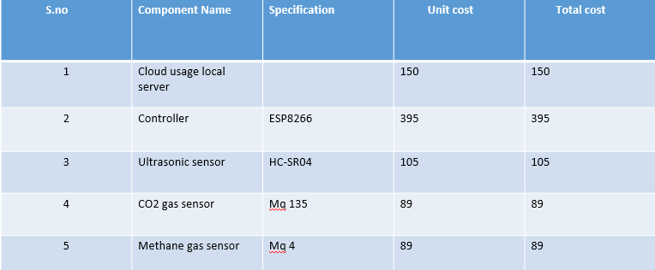
Cost Benefits Analysis
The components are cost-efficient and affordable

Slide 13
Working Video Link
https://drive.google.com/file/d/1uZYwHSwXwkmHEKbbfuB75uNt4T8opVty/view?usp=sharing
https://drive.google.com/file/d/1Y4j_SRilOjXAggRA9OZKzDq3UiA4b0Ts/view?usp=sharing

Slide 14
References
1.https://www.who.int/news/item/15-03-2016-an-estimated-12-6-million-deaths-each-year-are-attributable-to-unhealthy-environments
2.https://www.who.int/news-room/fact-sheets/detail/health-care-waste
3.https://www.statista.com/topics/4983/waste-generation-worldwide/#dossierKeyfigures
4.https://www.niti.gov.in/sites/default/files/2021-12/Waste-Wise-Cities.pdf
5.https://timesofindia.indiatimes.com/india/in-30-years-india-tipped-to-double-the-amount-of-waste-it-generates/articleshow/74454382.cms

